Slide 1
Week 17
AVL Trees - Balanced Binary Trees

Slide 2
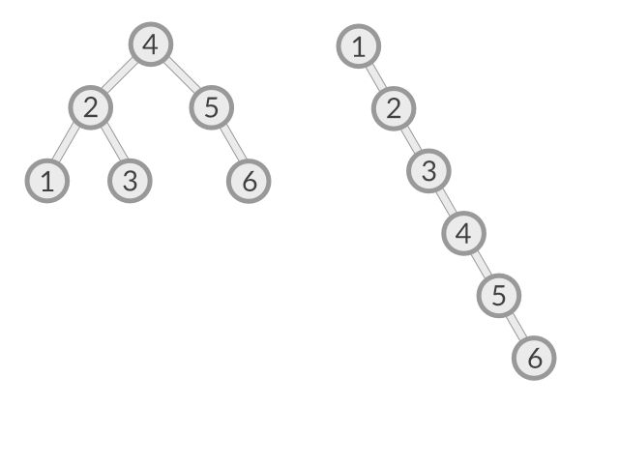
The Issue
Normal binary trees can result in linear search times
Different insertion orders changes the efficiency of searches
Search time is h where h is the height of the tree

Slide 3
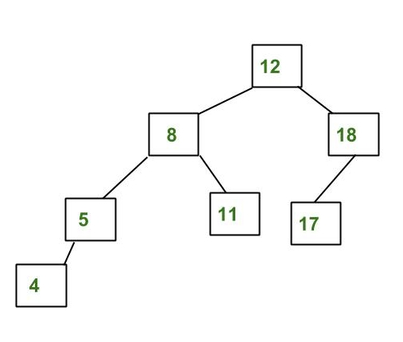
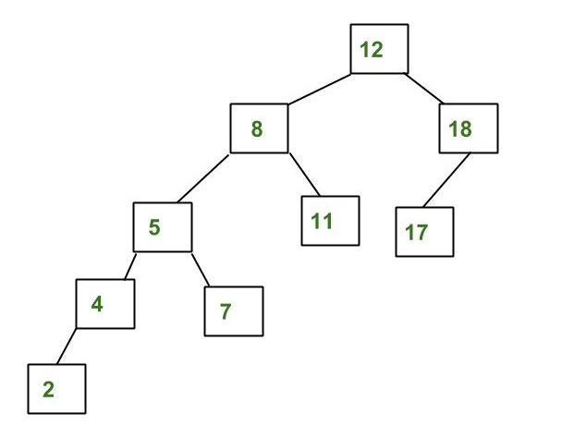
AVL Trees
AVL trees maintain an efficient search time by maintaining the fact that left and right subtrees never have a different in height greater than 1.
Maintaining this fact means that search time will always be log(n). However, it is difficult to keep this true.

Slide 4
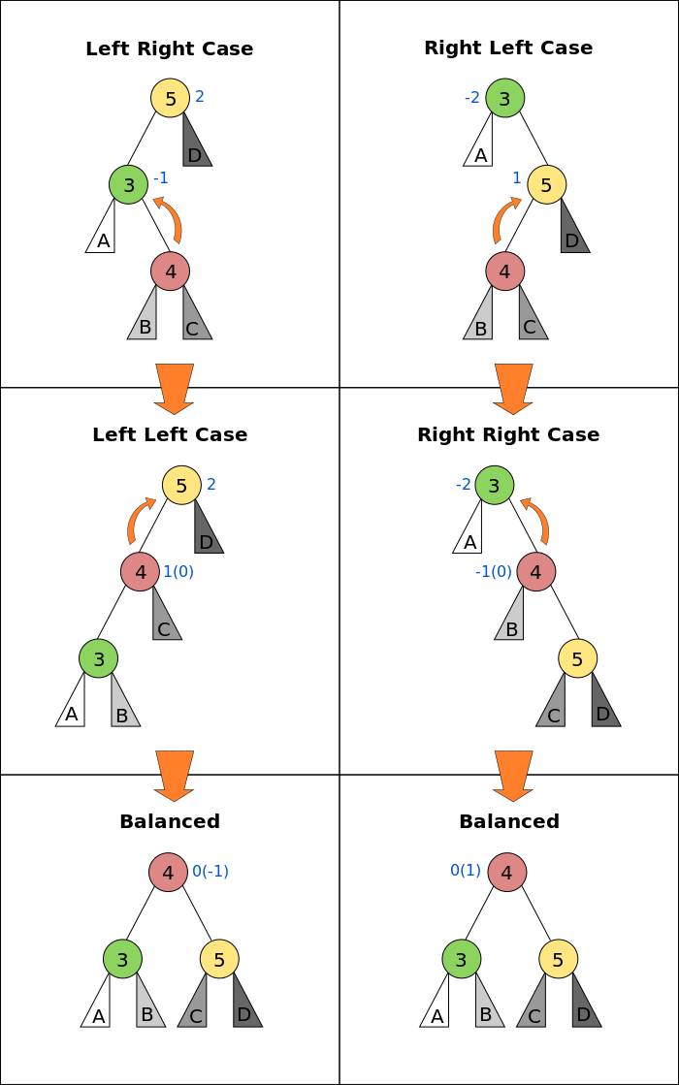
Insertion and Rotation
The invariant of AVL Trees is maintained using rotations around nodes. If we assume that the AVL Tree is normally balanced, then an imbalance only occurs during an insertion or deletion of a node.
Only one or two rotations are required for the tree to return to balanced
There are 4 cases where an insertion causes an imbalance in a node.

Slide 5
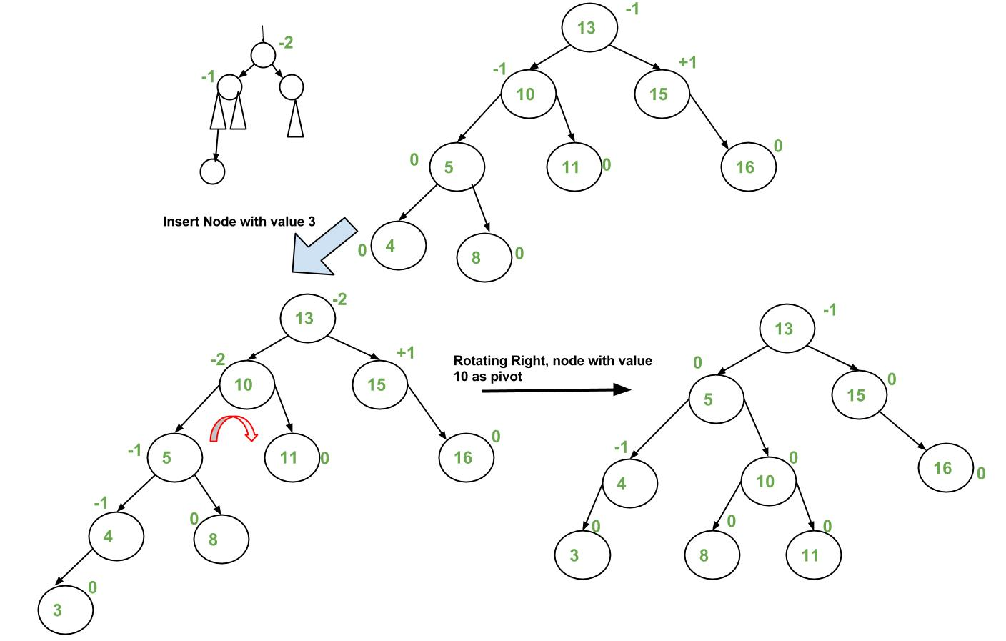
Insertion Example LL
Insert node like normal in binary trees.
Go up the tree and fix the node where an imbalance occurs if any
Choose left-left since the path from the imbalance node to inserted node starts with left then left

Slide 6
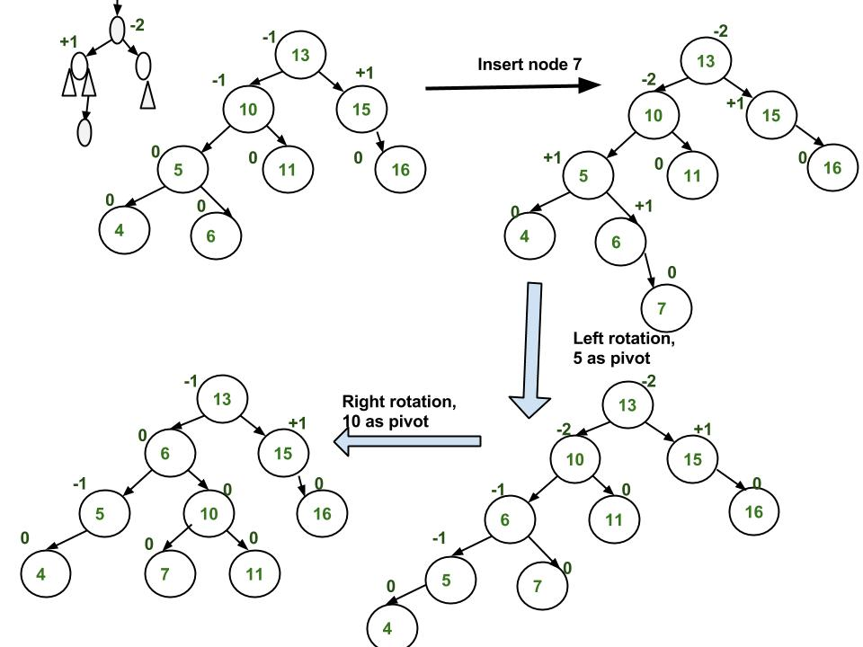
Insertion Example LR

Slide 7
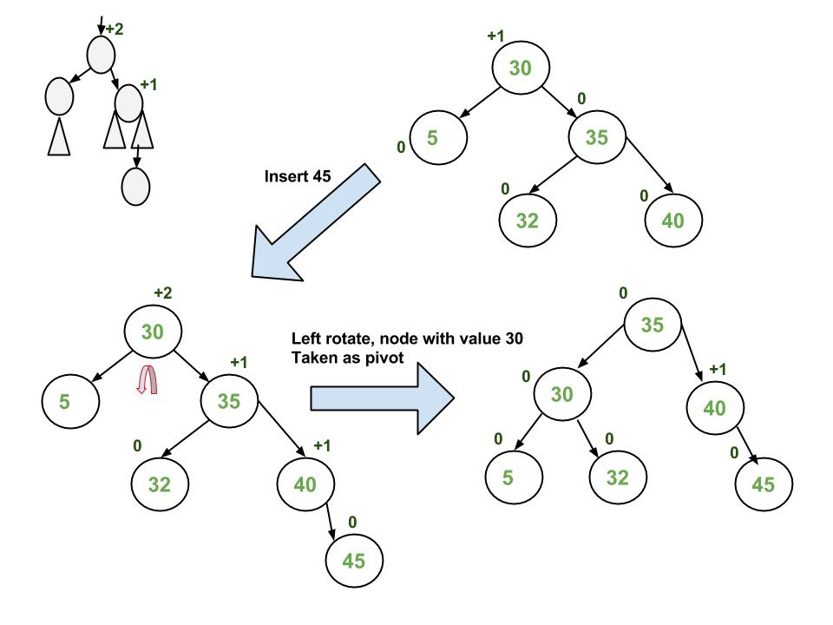
Insertion Example RR

Slide 8
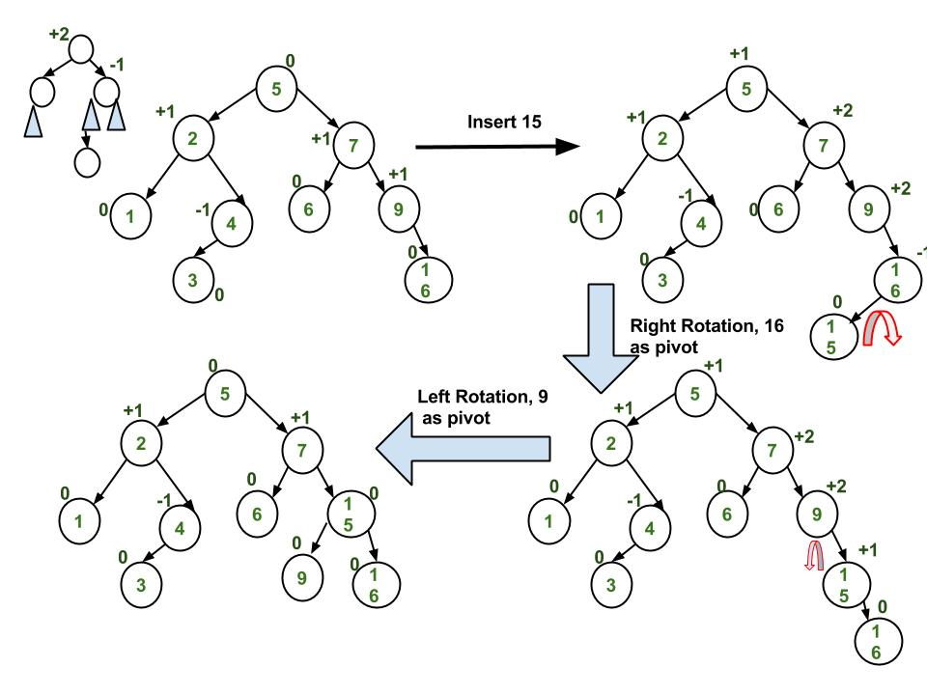
Insertion Example RL

Slide 9
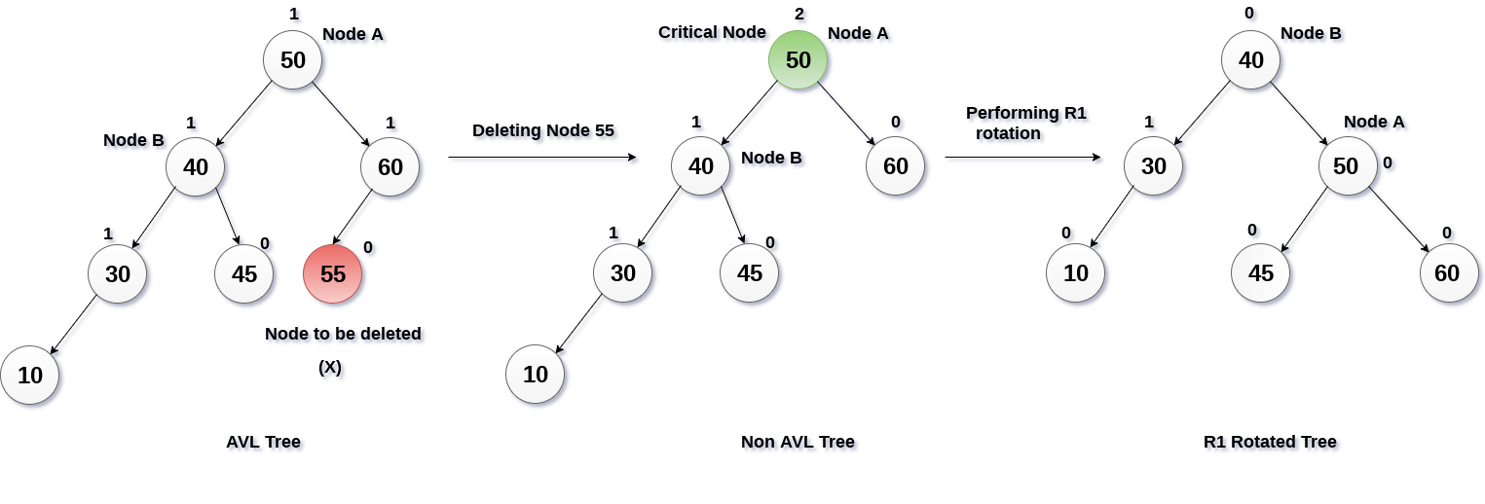
Deletion and Rotation
Deleting a node in an AVL Tree also requires rotations to maintain balance. However, it is possible for many more rotations to be required (log(n) rotations posible).
Similar to insertion, begin by regular deletion in a binary tree. Then we go up the tree and find the unbalanced node. We determine which rotation to use based on the path from the imbalance node to the deleted node.

Slide 10
Implementation
https://www.geeksforgeeks.org/avl-tree-set-1-insertion/
https://www.geeksforgeeks.org/avl-tree-set-2-deletion/

